Slide 1
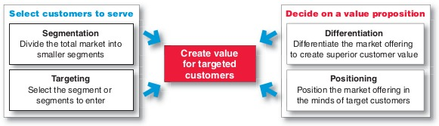
Customer-Driven Marketing Strategy
How will we create value for the target customers? How do we serve them?
Product Positioning
Source: Philip Kotler & Gary Armstrong
Notes:
Once a company has decided on which market segments to enter and which customers to target, it decides how it will serve them.
How their product will create a distinct value for its target customer and what position it wants to occupy in the chosen segment.
We’ll be talking about positioning, which is creating a product to occupy a clear, distinctive, and desirable place, in the target customer’s mind, relative to competing products.

Slide 2

In The Positioning Section, Students Will be Able to:
Define product positioning
Explain how companies position products against competitive offerings
Analyze real-world marketing scenarios
Notes:
Today, you’ll learn it’s all in the positioning.
Once we’ve defined product positioning, I’ll show you why America runs on Dunkin’.
Ready? Let’s go!

Slide 3
Product Position
How a product is defined by the consumer on attributes important to him/her
The place the product occupies in the consumer’s mind relative to competing products
Notes:
Al Ries and Jack Trout told us in their book, Positioning: The Battle for Your Mind, “Positioning is not what you do to a product. Positioning is what you do to the mind of the consumer.”
Brands happen in the mind of consumers.
A product’s position is the set of perceptions, impressions, beliefs, and feelings that consumers have for a product compared with other products in that same category – competing products.
You and I organize products and services into categories and “position” them in our minds. When we’re thinking of buying a product, we reference the set of products we placed in that category, and start our research and they buying process.

Slide 4
Positioning: An Essential Tool for How a Brand Will Compete in the Market
What the brand means, what it stands for
Best brands stand for something unique
BMW – Performance
Volvo – Safety
Rolls Royce – Luxury
How the product competes with others in the target market segment
Notes:
Product positioning is an essential tool for how a brand will compete in the market; it states the intended meaning of the brand.
The key is there should be one primary, meaningful benefit that sticks in the buyer’s mind. Brands that try to be many things all at the same time end up causing confusion.
The most successful positioning occurs when the company’s figured out how to be unique and difficult to copy.
As we have a lot of car enthusiasts in our group, we’re using the automobile market as our example on positioning.
Volvo is positioned around safety.
When you think of Rolls-Royce, what do you think of?
Ideally, a brand’s positioning is the same as its associations in the market.

Slide 5
Perceptual Positioning Map
Visually displays consumer perceptions of competing brands on two important buying dimensions
Perceptual maps show differentiation among products in the customer’s mind
Allows compare and contrast of competing products along certain criteria important to the target customer
  Can assess strengths and weaknesses relative to competing brands
Notes:
In planning their positioning, marketers often prepare positioning maps that show consumers’ perception of the brand versus competing products on attributes that are important to the consumer, whether functional or symbolic.
A price-benefit map helps you see, thru the eyes of your customers, the relationship between the primary benefit that the product provides to its target customers and the prices of all the competing products.

Slide 6
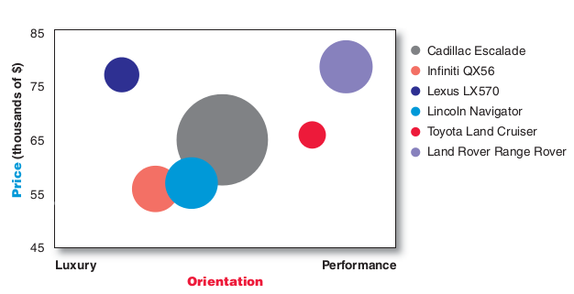
Positioning Map: Large Luxury SUVs 2010
Source: Philip Kotler & Gary Armstrong
Shows where consumers position an SUV brand on two dimensions: price and luxury-performance
Size of circle indicates relative 2010 market share in the Large SUV segment
Notes:
The result of the positioning map is a picture of the competitive landscape in the eyes of the customer.
Now that the products are “mapped together”, they can be compared and contrasted in relation to each other.
In this example, the position of each circle on the map indicates the brand’s perceived positioning on two dimensions important to the customer: price and orientation (luxury vs. performance) . The size of each circle on the map indicates the brand’s market share.
Brands positioned close to each other on a map are seen as similar by the consumer.
The Toyota Land Cruiser (red dot) is perceived to be relatively affordable and more performance oriented.
What do you think Lexus’ positioning is? (dark blue dot)

Slide 7
Your Turn: Populate a Positioning Map
Working first individually, then in your small groups, apply what you have learned about product positioning by determining where Cadillac, Lexus, Rolls-Royce, Scion, and Toyota, appear on the positioning map on the board.
      Axis: Retail Price (high/low) and Luxury/Economy
In your small groups, compare your choices then form consensus. Please write your names & results on the handout for submitting at the end of class.
Groups will simultaneously place their results on the positioning map using the 1st letter of each brand; we will discuss results as a group.
Notes:
Learning objective: Students apply marketing concept just covered
Topic coverage: Positioning and positioning maps just covered
Product: Using think>pair>share, students simultaneously place the car brands on the positioning map on the white board. On a sheet of paper, students map their group results and write group member names. Students submit this sheet of paper at end of class.
Assessment: This is an in-class learning exercise rather than an evaluative exercise. I can use it as an attendance check.

Slide 8

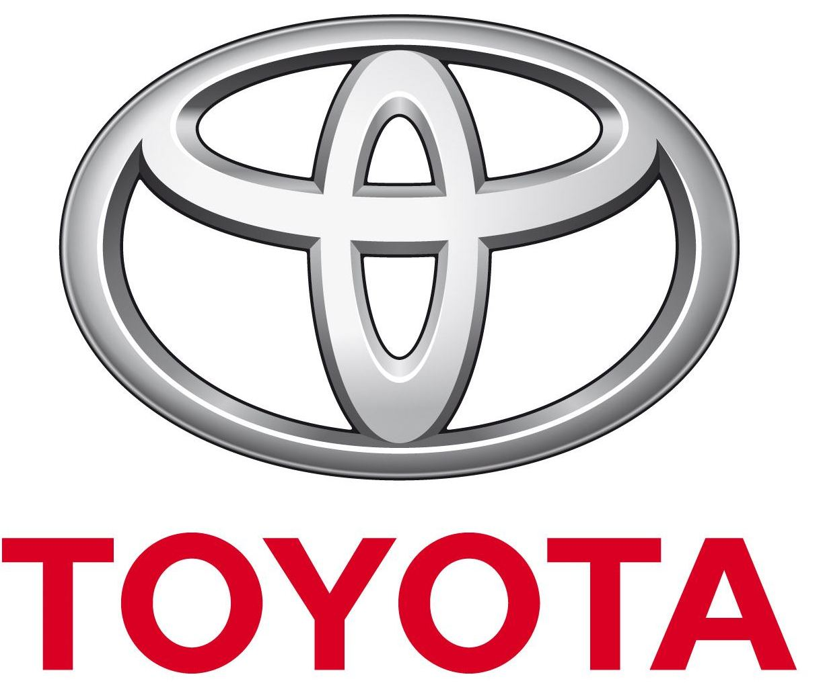

Differentiated (Segmented) Marketing
Company targets several market segments and designs separate products for each segment
Toyota Corporation
Each of these Toyota brands targets a different segment of car buyers
Successful differentiation
        Generates customer value
        Provides perceived value

Slide 9

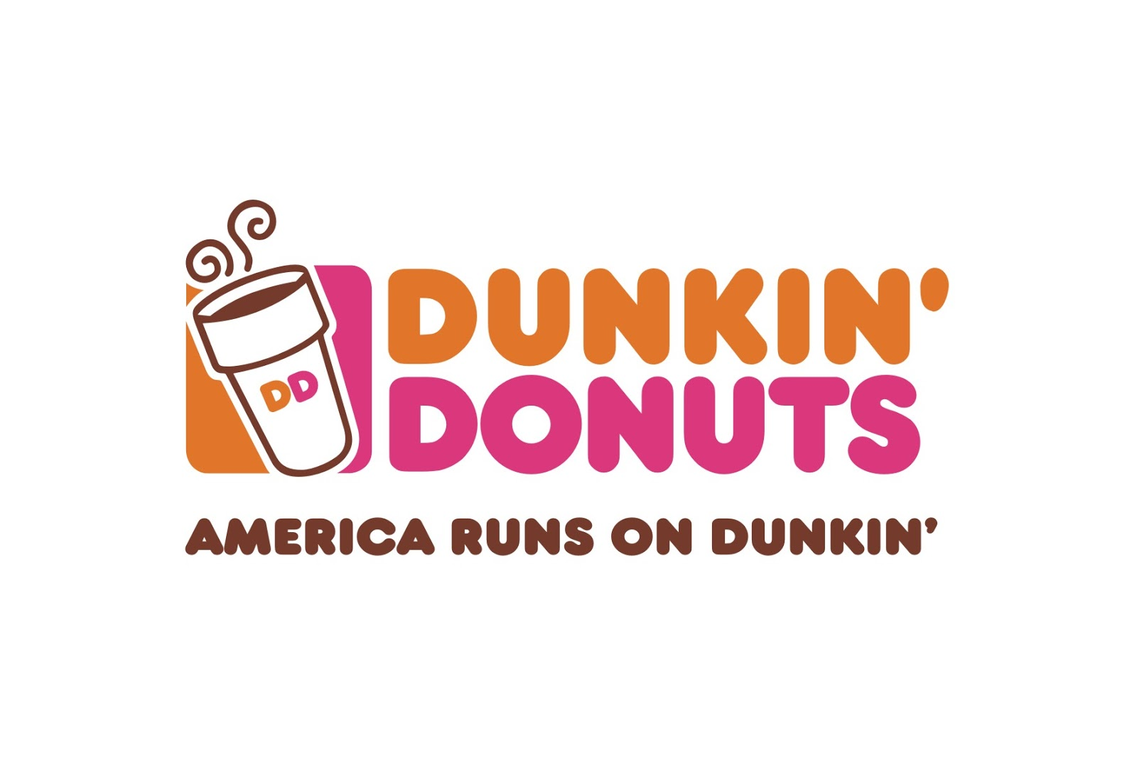
A Tale of Two Joes
Notes:
Positioning must serve the needs and preferences of a well-defined target market.
Ideally, a product’s positioning is the same as its associations in the market place.

Slide 10
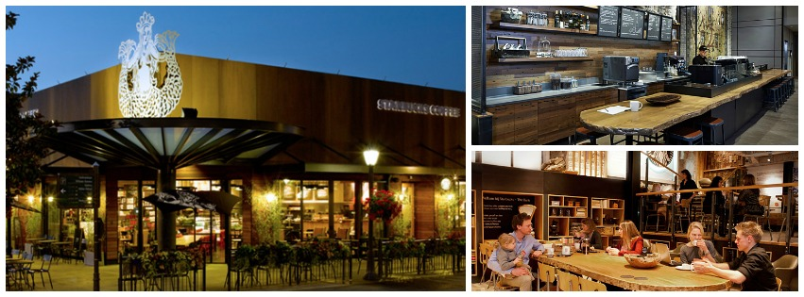
Starbucks
Image source: Starbucks
Notes:
Class will discuss perceived target audience and positioning, and how Starbucks’ marketing mix elements (product, price, promotion, place/distribution) support its product positioning.

Slide 11
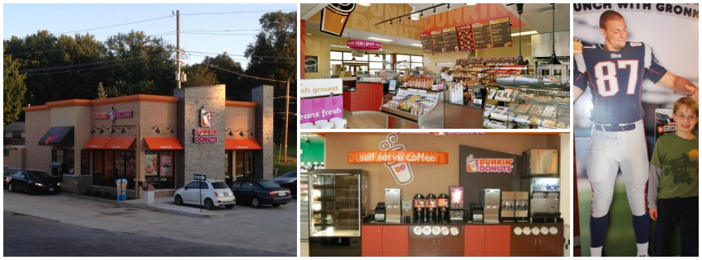
Dunkin’ Donuts
Image sources: Dmar Construction, Prellwitz Chilinski Associates
Notes:
Class will discuss perceived target audience and positioning, and how Dunkin’s marketing mix elements support its product positioning.

Slide 12
America Runs on Dunkin’
Dunkin’ has an “everyman” kind of positioning. Its ads show ordinary people relying on the company to get them thru to day.
The campaign cheers on everyday people who keep America running by reminding them they can take on any task, even during challenging times.
Notes:
Now that we’ve discussed which customers Dunkin’ wants to serve and how , ou can see that Dunkin’s positioning is pretty well summed up in its ad slogan, “America Runs on Dunkin’”
America runs on Dunkin’ – it’s where everyday people get things done every day.

Slide 13
Product Position
The place the product occupies in the target customer’s mind relative to competing products
Company identifies and selects one primary benefit on which to position itself vs. competitive offerings
If the company positions its products as offering the best quality, it must actually differentiate the product so that it delivers the promised level of quality.
Company must then effectively deliver and communicate the chosen position to its target market
Notes:
Positioning is what a brand means – what it stands for. The best brands stand for something unique that is important and of value to the target customer.
Positioning must serve the needs and preferences of well-defined target markets.
Positioning tells how a brand competes in the market.
As a marketer, you must plan the positioning that will give your product the greatest competitive advantage in your selected, well-defined target market.
Once the product positioning has been selected, a company must take strong steps to deliver and communicate the position to its target customers.
All of the marketing mix elements –product, price, promotion, and distribution- must support the positioning strategy.
No positioning will work forever. You have to monitor and gradually adapt the position over time to match the changes in the target customer’s needs and wants, and your competitor’s strategy.

Slide 14
“Today was good. Today was fun. Tomorrow is another one.”
Additional reading: positioning & branding
David Aaker: prophet.com, branding books
Tim Calkins: Breakthrough Marketing Plans
Al Reis and Jack Trout: Positioning: The Battle for Your Mind
“3-2-1” assignment due 9:00 p.m. tonight
    Please complete on BlackBoard; I will review and post answers online by the next class. Thank you!
Homework
    Please complete the homework assignment posted on BlackBoard and bring it to next class
Next class
  Value proposition
  Products & services
  Branding
Notes:
I enjoyed our conversation and class today!
To continue your learning on positioning and branding, which we will discuss next time, here are some great resources for you. There are also some additional positioning notes on BlackBoard.
Please let me know what you found most clear and what you’re not sure about in today’s class by completing the online Muddiest Point assignment by 9:00 tonight.
Please leave your positioning maps on my desk and don’t forget to complete and bring in your homework to the next class!
Have a great afternoon!

