Slide 1
You will write 3 Facebook posts for your business' Facebook Business Page.
Scenario:
It is 8:00 a.m. on Monday, 2/29. You just realized that you have not planned any posts for your company's Facebook Business Page for this week. You are out of the office all week and this is the only time you have to create 3 Facebook posts.
You have 5 minutes to get this done.
Steps to Write Your Facebook Posts:
1. Select 3 days of this week to post on: Monday, 2/29; Tues. 3/1; Wedn., 3/2; Thurs., 3/3; Friday,3/4; Saturday, 3/5
2. For each of the 3 Facebook posts, write down:
-Day of week
-Date
-Time of day
-Post text
-Image or video description
-Website link (If applicable, write a description of the page on your website or a news/magazine website that you are linking to. Eg: The menu page on my website, the services page on my website, the article on my company in MetroWest Daily News)
Notes:
In this “real-world” simulation, students will create 3 posts for their small business’ Facebook Business page. Students will experience what social media posting last-minute and without a plan looks and feels like.
1

Slide 2
In Today's Class, Students Will be Able to:
Explain a Social Media Content Calendar and Its Benefits Apply Facebook Insights Information to Facebook Posts Plan 3 Posts in a Social Media Content Calendar for A Facebook Business Page
Notes:
Today, you’ll start learning about Social Media Content Calendars.
Once we’ve explained how content calendars can help make managing social media easier and provide better value to your target audience, we’ll plan 3 Facebook posts for Davidson’s Landscaping, which is a student’s business.
Ready to meet your company’s new best friend?
2

Slide 3
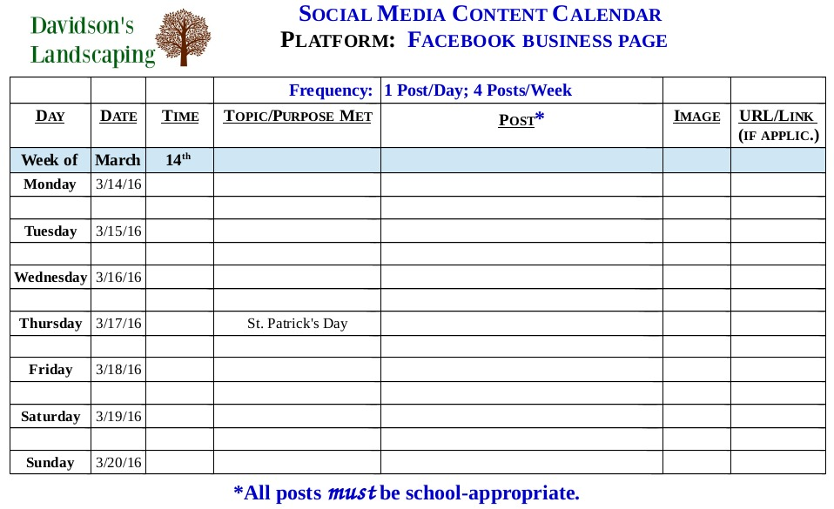
Notes:
Your small business is going to move fast and you’ll have a lot on your plate, which is why your social media content calendar will become your new best friend.
Managing all the parts of your social media presence takes planning.
To grow and nurture an audience on social media, it’s not as simple as just “winging-it” and posting whatever and whenever you feel like it.
You need a plan and a view of the big picture.
3

Slide 4
How Can A Content Calendar Help?
Plan Ahead Maintain Sanity Craft Timely Content Engage with Audience
Save Time
Think Further Than Today or Tomorrow
Keep Organized
Ensure There’s Always Content Going Out
Stay on Track with Goals
Minimize The Chaos of Last Minute Posting
Feel Confident That Your Upcoming Days/Weeks are Planned
Focus on Audience’s Needs
Share Content at Best Day/Time So Your Fans See It
Post Consistently
Plan for Relevant Holidays & Events
Provide Value
Grow Reach (fans & non-fans)
Develop Brand Loyalty
Notes:
A content calendar keeps all of your social media activities organized.
It helps you visualize all of your posts and is a road map to make sure your content is optimized so your target audience sees it.
And knowing what kind of content you’re going to share and when you’re going to share it is key to making sure you get the engagement you desire.
The most important way to use social media is to engage with your audience.
4

Slide 5
Your Turn
Image source: Social Media Today
Notes:
Class will discuss as a group on write on the board ways they think a social media content calendar can help their business.
5

Slide 6
Complete Your Content Calendar in 3 Easy Steps. Determine:
How Often to Post
When To Post
What To Post
Notes:
Making a social media content calendar is easy.
First, you decide how often you want to post.
Facebook has a more “community” feeling. Your fans are interested in your content – but they don’t want to be overwhelmed by it.
For a small business like yours, posting 3-4 days/week might be a good place to start.
The key is to post consistently to help set expectations with your fans and to increase your reach and engagement.
You’re basically going to make a drumbeat to your posting schedule.
6

Slide 7
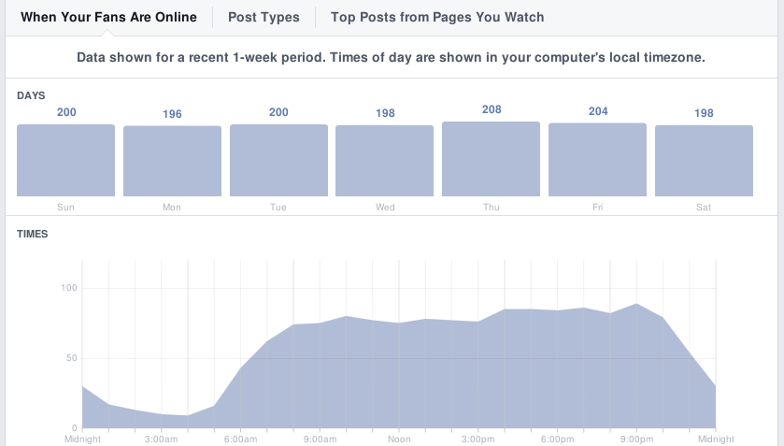
When and What to Post: Facebook Insights
Notes:
Next, you want to know the best days and times to post so your audience actually sees your content.
You can use Facebook Insights to learn what time your fans are on Facebook and when they engage most with your posts.
7

Slide 8
When and What to Post: Facebook Insights
Fans l Non-Fans
Notes:
You can also use Insights to see what kind of content your audience likes best – videos, pictures, how-to’s, links.
And you can see how well your posts have performed – number of likes, comments, shares, clicks, and video views.
8

Slide 9
Best Times to Post on Mondays
Best Types of Posts for Your Page
6:45 a.m. 12:00 p.m.
3:45 p.m. 8:00 p.m.
-Videos -Pictures -Links to Articles and Your Website
-#MakeoverMonday (Before & after pictures – visual storytelling)
-#FridayTips (Posts about lawncare & maintenance, planting, landscape design, etc.)
-How-To videos and article links
Notes:
9

Slide 10
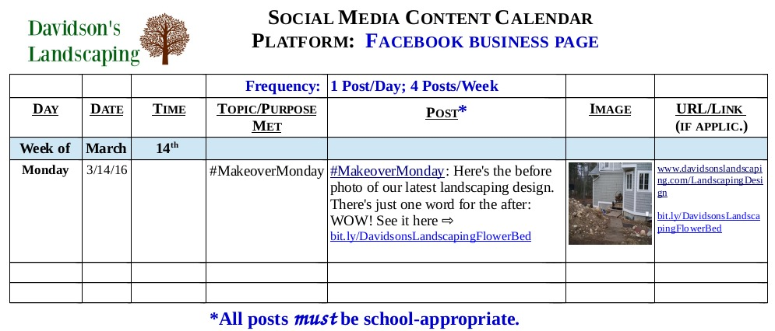
Notes:
10

Slide 11
Your Turn: Plan Two Facebook Posts
Working in pairs, write 2 posts for Facebook Business Page. You have 15 minutes to get this done.
Steps:
Create posts for: Thursday, 3/17 and Friday, 3/18
1. On The Social Media Calendar, Fill in:
Time
Post text
Describe the image you will use
URL or name of website you’re linking to (eg: Garden Design Magazine) (if applic.)
2. Write you names on the calendar for turning in at the end of class.
3. We will discuss your results as a group.
Notes:
Learning objective: Students apply marketing concept just covered
Topic coverage: Social Media Content Calendar
Product: In pairs, students compose two posts on a social media calendar for a student’s business. Students submit this sheet of paper at end of class.
Assessment: This is an in-class learning exercise rather than an evaluative exercise. I can use it as an attendance check.
11

Slide 12
You + Social Media Content Calendar =
A Social Media Content Calendar Has Lots of Benefits for Businesses
Save Time by Planning Ahead
Have Peace of Mind
Publish Well-Written, Relevant, High-Quality Posts
Engage with Your Customers, Partners, and Potential Customers
Stay on Track with Your Social Media Goals
Help Grow Your Business
Use The Content Calendar for All of Your Business’ Social Media Platforms
Notes:
Ultimately, a content calendar can help make managing social media easier and can be a powerful tool to help you grow your business.
With a few small steps – and a little effort- you can take your social media presence from adequate to awesome.
12

Slide 13
“Today was good. Today was fun. Tomorrow is another one”
3-2-1 Paper
Look at Facebook Business Pages for Your Type of Business
Next Class
Social Media Content Calendars
Facebook Business Page Posts & Visual Storytelling
Notes:
I enjoyed our conversation and class today! Thank you so much for welcoming me into your classroom.
Please take a moment to answer the 3-2-1 paper on today’s class.
Look at Facebook Business Pages for your type of business. Look at what types of things they post, when they post, and how many times a week they post. Look at their visual storytelling.
Please leave your group work on the table.
Have a great afternoon!
13

